Slide 1
Wireless Networking
Lecture 7 - Brief Introduction to Deep Learning

Slide 2
Contents
Overview of the Component
Linear Regression
Classification: Logistic Regression
Basics for Deep Learning
Backpropagation
Basics for CNN

Slide 3
Overview of the Component

Slide 4

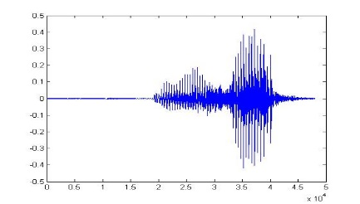
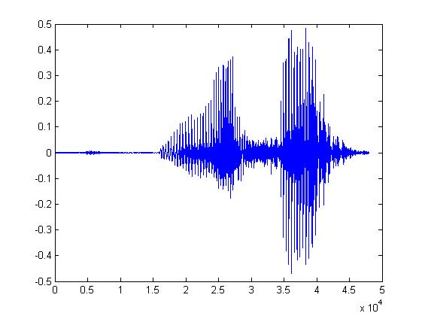
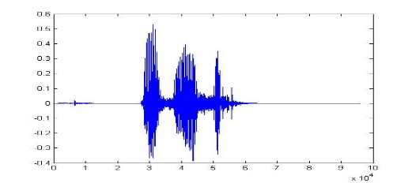
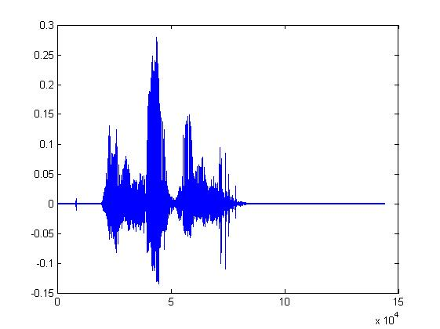
What is Machine Learning?
Learning ......
“Hi”
“How are you”
You said “Hello”
“Good bye”
You write the program for learning.
A large amount of audio data

Slide 5


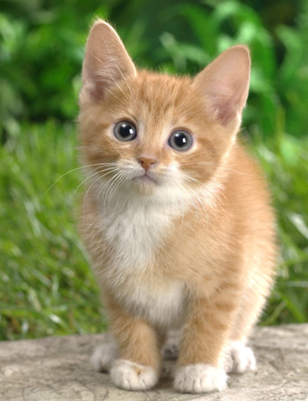

What is Machine Learning?
Learning ......
“monkey”
“cat”
This is “cat”
“dog”
You write the program for learning.
A large amount of images

Slide 6

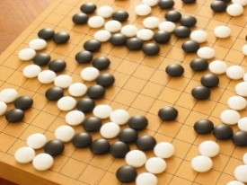
Machine Learning ≈ Looking for a Function
Speech Recognition
Image Recognition
Playing Go
Dialogue System
“How are you”
“Cat”
“5-5”
(next move)
“Hi”
“Hello”
(what the user said)
(system response)

Slide 7
Framework
Image Recognition:
“cat”
A set of function
Model
“cat”
“money”
“dog”
“snake”
Notes:
Repeat again

Slide 8
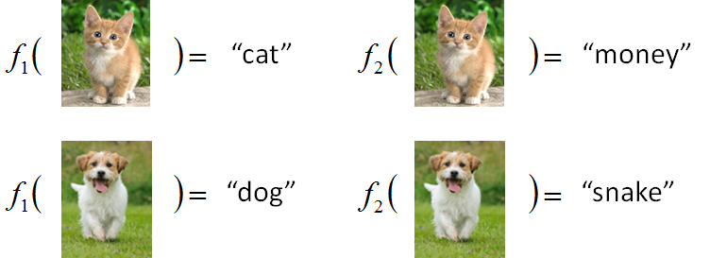
Framework
Image Recognition:
“cat”
A set of function
Model
Better!
Goodness of function f
Training
Data
function input:
function output:
“monkey”
“cat”
“dog”
Notes:
Repeat again

Slide 9
Framework
Image Recognition:
“cat”
A set of function
Model
Training
Testing
“cat”
Step 1
Goodness of function f
Pick the “Best” Function
Using
Step 2
Step 3
Training
Data
“monkey”
“cat”
“dog”
Notes:
Repeat again

Slide 10
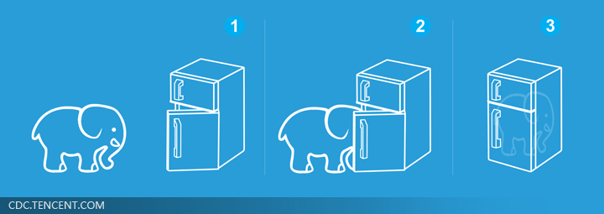
Machine Learning is so simple ……
Step 1: define a set of function
Step 2: goodness of function
Step 3: pick the best function
就好像把大象放進冰箱 ……

Slide 11
Learning Map
Regression
Linear Model
Deep Learning
Mobile DL
SW,HW
Non-linear Model
Classification

Slide 12
Linear Regression

Slide 13

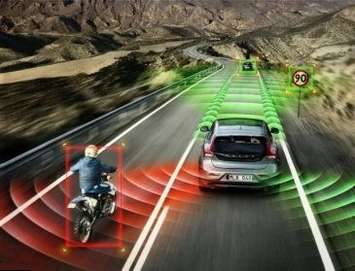
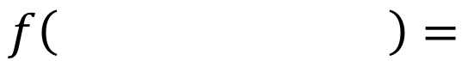
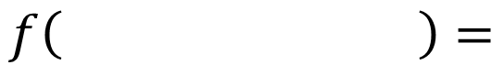
Regression: Output a scalar
Stock Market Forecast
Self-driving Car
Recommendation
Dow Jones Industrial Average at tomorrow
$$f\left( \right)=$$
$$f\left( \right)=$$
Rotation angle
$$f\left( \right)=$$
Propability of Purchase
Comsumer A
Goods B

Slide 14

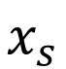
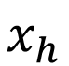
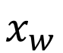
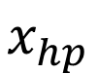
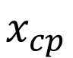
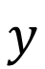
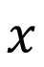
Example Application
Estimating the Combat Power (CP) of a pokemon after evolution
$$x_{cp}$$
CP after evolution
$$f\left( \right)=$$
$$y$$
$$x_{s}$$
$$x$$
$$x_{hp}$$
$$x_{w}$$
$$x_{h}$$
Notes:
xcp: 未进化的cp值。

Slide 15
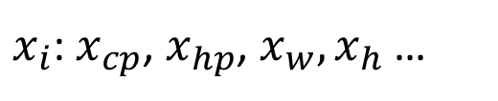
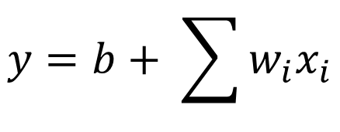
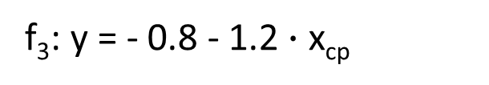
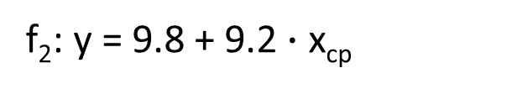
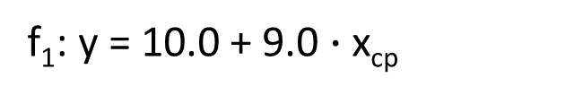
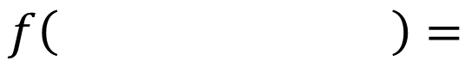
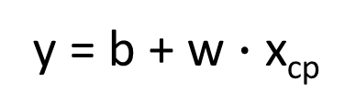
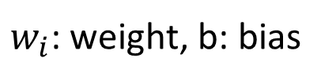
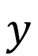
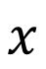
Step 1: Model
w and b are parameters (can be any value)
y = b + w $∙$ x_{cp}
f₁: y = 10.0 + 9.0 $∙$ x_{cp}
A set of function
Model
f₂: y = 9.8 + 9.2 $∙$ x_{cp}
f₃: y = - 0.8 - 1.2 $∙$ x_{cp}
…… infinite
CP after evolution
$$x$$
$$y$$
$$f\left( \right)=$$
$x_{i}$: $x_{cp}$, $x_{hp}$, $x_{w},x_{h}$ …
$$y=b+ \sum{w_{i}x_{i}}$$
Linear model:
feature
$w_{i}$: weight, b: bias

Slide 16

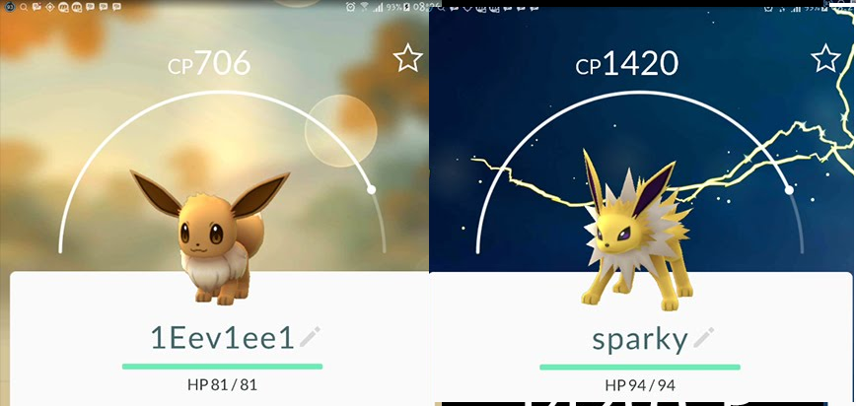
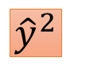
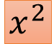
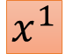
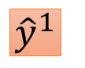
Step 2: Goodness of Function
y = b + w $∙$ x_{cp}
A set of function
Model
function
input:
function
Output (scalar):
$${\hat{y}}^{1}$$
$$x^{1}$$
$${\hat{y}}^{2}$$
$$x^{2}$$
Training
Data
Notes:
卡咪龜

Slide 17
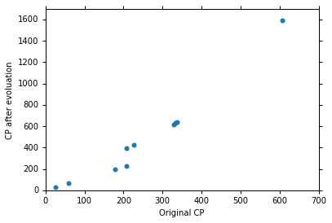
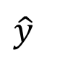
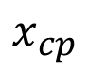
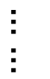
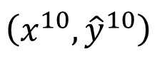
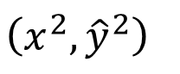
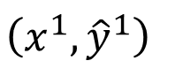
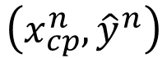
Step 2: Goodness of Function
Training Data: 10 pokemons
$$\left(x^{1},{\hat{y}}^{1}\right)$$
$$\left(x^{2},{\hat{y}}^{2}\right)$$
$$\left(x_{cp}^{n},{\hat{y}}^{n}\right)$$
$$……$$
$$\hat{y}$$
$$\left(x^{10},{\hat{y}}^{10}\right)$$
This is real data.
$$x_{cp}$$
Source: https://www.openintro.org/stat/data/?data=pokemon

Slide 18
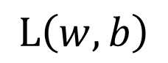
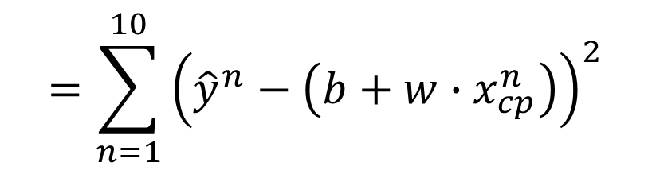
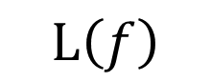
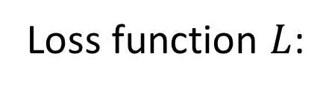
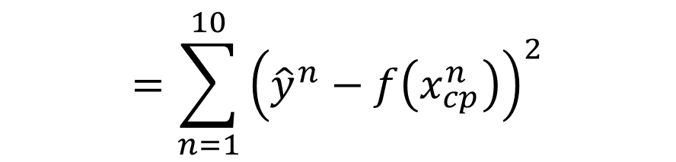
Step 2: Goodness of Function
y = b + w $∙$ x_{cp}
A set of function
Loss function $L$:
Model
Input: a function, output: how bad it is
Estimation error
$$=\sum_{n=1}^{10}{{\left({\hat{y}}^{n}−f\left(x_{cp}^{n}\right)\right)}^{2}}$$
Goodness of function f
$$L\left(f\right)$$
Estimated y based on input function
Sum over examples
Training
Data
$$L\left(w,b\right)$$
$$=\sum_{n=1}^{10}{{\left({\hat{y}}^{n}−\left(b+w∙x_{cp}^{n}\right)\right)}^{2}}$$

Slide 19
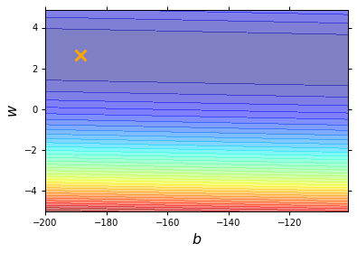
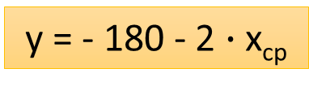
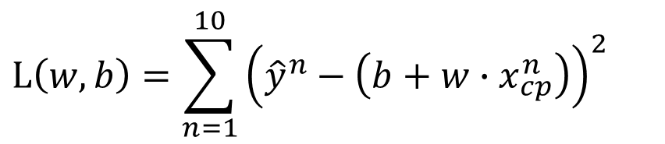
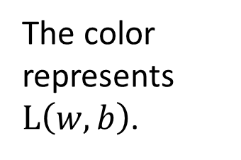
Step 2: Goodness of Function
$$L\left(w,b\right)=\sum_{n=1}^{10}{{\left({\hat{y}}^{n}−\left(b+w∙x_{cp}^{n}\right)\right)}^{2}}$$
Loss Function
Each point in the figure is a function
smallest
y = - 180 - 2 $∙$ x_{cp}
The color represents $L\left(w,b\right)$.
Very large
(true example)

Slide 20




Step 3: Best Function
$$L\left(w,b\right)$$
$$=\sum_{n=1}^{10}{{\left({\hat{y}}^{n}−\left(b+w∙x_{cp}^{n}\right)\right)}^{2}}$$
A set of function
Model
Goodness of function f
Pick the “Best” Function
$$f^{∗}=\arg{\min_{f}{L\left(f\right)}}$$
Gradient Descent
Training
Data
$$w^{∗},b^{∗}=arg\min_{w,b}{L\left(w,b\right)}$$
$$=arg\min_{w,b}{\sum_{n=1}^{10}{{\left({\hat{y}}^{n}−\left(b+w∙x_{cp}^{n}\right)\right)}^{2}}}$$
Notes:
http://speech.ee.ntu.edu.tw/~tlkagk/courses/LA_2016/Lecture/orthogonal%20projection%20(v2).ecm.mp4/index.html

Slide 21




Step 3: Gradient Descent
http://chico386.pixnet.net/album/photo/171572850
$$w^{∗}=arg\min_{w}{L\left(w\right)}$$
Consider loss function 𝐿(𝑤) with one parameter w:
(Randomly) Pick an initial value w⁰
Compute $\frac{dL}{dw}|_{w=w^{0}}$
Loss
$$L\left(w\right)$$
Negative
Increase w
Positive
Decrease w
w⁰

Slide 22


Step 3: Gradient Descent
http://chico386.pixnet.net/album/photo/171572850
$$w^{∗}=arg\min_{w}{L\left(w\right)}$$
Consider loss function 𝐿(𝑤) with one parameter w:
(Randomly) Pick an initial value w⁰
Compute $\frac{dL}{dw}|_{w=w^{0}}$
$$w^{1}←w^{0}−η\frac{dL}{dw}|_{w=w^{0}}$$
Loss
$$L\left(w\right)$$
η is called “learning rate”
w⁰
$$−η\frac{dL}{dw}|_{w=w^{0}}$$

Slide 23



Step 3: Gradient Descent
$$w^{∗}=arg\min_{w}{L\left(w\right)}$$
Consider loss function 𝐿(𝑤) with one parameter w:
(Randomly) Pick an initial value w⁰
Compute $\frac{dL}{dw}|_{w=w^{0}}$
$$w^{1}←w^{0}−η\frac{dL}{dw}|_{w=w^{0}}$$
Loss
$$L\left(w\right)$$
Compute $\frac{dL}{dw}|_{w=w^{1}}$
$$w^{2}←w^{1}−η\frac{dL}{dw}|_{w=w^{1}}$$
…… Many iteration
Local minima
global minima
w⁰
w¹
w²
w^{T}

Slide 24








Step 3: Gradient Descent
$$\left[\begin{aligned}\frac{∂L}{∂w} \\ \frac{∂L}{∂b}\end{aligned}\right]$$
$$∇L=$$
gradient
How about two parameters?
$$w^{∗},b^{∗}=arg\min_{w,b}{L\left(w,b\right)}$$
(Randomly) Pick an initial value w⁰, b⁰
Compute $\frac{∂L}{∂w}|_{w=w^{0},b=b^{0}}$, $\frac{∂L}{∂b}|_{w=w^{0},b=b^{0}}$
$$w^{1}←w^{0}−η\frac{∂L}{∂w}|_{w=w^{0},b=b^{0}}$$
$$b^{1}←b^{0}−η\frac{∂L}{∂b}|_{w=w^{0},b=b^{0}}$$
Compute $\frac{∂L}{∂w}|_{w=w^{1},b=b^{1}}$, $\frac{∂L}{∂b}|_{w=w^{1},b=b^{1}}$
$$w^{2}←w^{1}−η\frac{∂L}{∂w}|_{w=w^{1},b=b^{1}}$$
$$b^{2}←b^{1}−η\frac{∂L}{∂b}|_{w=w^{1},b=b^{1}}$$
Notes:
鄭凱文

Slide 25





Step 3: Gradient Descent
Color: Value of Loss L(w,b)
$$w$$
$(−η{∂L}/{∂b}$, $−η{∂L}/{∂w})$
Compute ${∂L}/{∂b}$, ${∂L}/{∂w}$
$$b$$
Notes:
Don’t worry. In linear regression, the loss function L is convex.
No local minima
Questions: image you are playing AOC
A network can have millions of parameters.
Backpropagation is the way to compute the gradients efficiently (not today)
Ref: http://speech.ee.ntu.edu.tw/~tlkagk/courses/MLDS_2015_2/Lecture/DNN%20backprop.ecm.mp4/index.html

Slide 26







Step 3: Gradient Descent
Loss
Very slow at the plateau
$$L$$
Stuck at saddle point
$$w_{1}$$
$$w_{2}$$
Stuck at local minima
$$∂L∕∂w$$
$$≈0$$
$$∂L∕∂w$$
$$=0$$
$$∂L∕∂w$$
$$=0$$
The value of the parameter w
Notes:
Demo: Why all the problmes/

Slide 27





Step 3: Gradient Descent
Formulation of ${∂L}/{∂w}$ and ${∂L}/{∂b}$
$$L\left(w,b\right)=\sum_{n=1}^{10}{{\left({\hat{y}}^{n}−\left(b+w∙x_{cp}^{n}\right)\right)}^{2}}$$
$$\sum_{n=1}^{10}{2\left({\hat{y}}^{n}−\left(b+w∙x_{cp}^{n}\right)\right)\left(−x_{cp}^{n}\right)}$$
$$\frac{∂L}{∂w}=?$$
$$\frac{∂L}{∂b}=?$$

Slide 28

Step 3: Gradient Descent
Formulation of ${∂L}/{∂w}$ and ${∂L}/{∂b}$
$$L\left(w,b\right)=\sum_{n=1}^{10}{{\left({\hat{y}}^{n}−\left(b+w∙x_{cp}^{n}\right)\right)}^{2}}$$
$$\sum_{n=1}^{10}{2\left({\hat{y}}^{n}−\left(b+w∙x_{cp}^{n}\right)\right)\left(−x_{cp}^{n}\right)}$$
$$\frac{∂L}{∂w}=?$$
$$\frac{∂L}{∂b}=?$$
$$\sum_{n=1}^{10}{2\left({\hat{y}}^{n}−\left(b+w∙x_{cp}^{n}\right)\right)\left(−1\right)}$$

Slide 29





How’s the results?
Training Data
y = b + w $∙$ x_{cp}
b = -188.4
$$e^{1}$$
w = 2.7
Average Error on Training Data
$$e^{2}$$
$$=\frac{1}{10}\sum_{n=1}^{10}{e^{n}}$$
= 31.9

Slide 30


How’s the results? - Generalization
What we really care about is the error on new data (testing data)
Another 10 pokemons as testing data
y = b + w $∙$ x_{cp}
b = -188.4
How can we do better?
w = 2.7
Average Error on Testing Data
$$=\frac{1}{10}\sum_{n=1}^{10}{e^{n}}$$
= 35.0
> Average Error on Training Data (31.9)

Slide 31



Selecting another Model
y = b + w₁ $∙$ x_{cp} + w₂ $∙$ (x_{cp})²
Best Function
b = -10.3
w₁ = 1.0, w₂ = 2.7 x 10⁻³
Average Error = 15.4
Testing:
Average Error = 18.4
Better! Could it be even better?

Slide 32



Selecting another Model
y = b + w₁ $∙$ x_{cp} + w₂ $∙$ (x_{cp})²
+ w₃ $∙$ (x_{cp})³
Best Function
b = 6.4, w₁ = 0.66
w₂ = 4.3 x 10⁻³
w₃ = -1.8 x 10⁻⁶
Average Error = 15.3
Testing:
Average Error = 18.1
Slightly better.
How about more complex model?

Slide 33



Selecting another Model
y = b + w₁ $∙$ x_{cp} + w₂ $∙$ (x_{cp})²
+ w₃ $∙$ (x_{cp})³ + w₄ $∙$ (x_{cp})⁴
Best Function
Average Error = 14.9
Testing:
Average Error = 28.8
The results become worse ...

Slide 34



Selecting another Model
y = b + w₁ $∙$ x_{cp} + w₂ $∙$ (x_{cp})²
+ w₃ $∙$ (x_{cp})³ + w₄ $∙$ (x_{cp})⁴
+ w₅ $∙$ (x_{cp})⁵
Best Function
Average Error = 12.8
Testing:
Average Error = 232.1
The results are so bad.

Slide 35






Model Selection
Training Data
1.
y = b + w $∙$ x_{cp}
2.
y = b + w₁ $∙$ x_{cp} + w₂ $∙$ (x_{cp})²
y = b + w₁ $∙$ x_{cp} + w₂ $∙$ (x_{cp})²
+ w₃ $∙$ (x_{cp})³
3.
y = b + w₁ $∙$ x_{cp} + w₂ $∙$ (x_{cp})²
+ w₃ $∙$ (x_{cp})³ + w₄ $∙$ (x_{cp})⁴
4.
y = b + w₁ $∙$ x_{cp} + w₂ $∙$ (x_{cp})²
+ w₃ $∙$ (x_{cp})³ + w₄ $∙$ (x_{cp})⁴
+ w₅ $∙$ (x_{cp})⁵
A more complex model yields lower error on training data.
5.
If we can truly find the best function

Slide 36

Model Selection
 | Training | Testing
1 | 31.9 | 35.0
2 | 15.4 | 18.4
3 | 15.3 | 18.1
4 | 14.9 | 28.2
5 | 12.8 | 232.1
Overfitting
A more complex model does not always lead to better performance on testing data.
This is Overfitting.
Select suitable model
Notes:
metaphohr

Slide 37
Classification: Logistic Regression

Slide 38







Step 1: Function Set
Function set:
Including all different w and b
$$P_{w,b}\left(C_{1}|x\right)≥0.5$$
class 1
z
0
$$P_{w,b}\left(C_{1}|x\right)<0.5$$
class 2
z
0
$$P_{w,b}\left(C_{1}|x\right)=σ\left(z\right)$$
^{[1]}
$$=\sum_{i}{w_{i}x_{i}}+b$$
$$z=w∙x+b$$
$$σ\left(z\right)=\frac{1}{1+exp\left(−z\right)}$$
[1] Bishop: Chapter 4.1 – 4.2

Slide 39

Step 1: Function Set
…
…
$$P_{w,b}\left(C_{1}|x\right)$$
…
…
Sigmoid Function
Notes:
Activation function

Slide 40










Step 2: Goodness of a Function
Training
Data
$$x^{1}$$
$$x^{2}$$
$$x^{3}$$
$$x^{N}$$
$$……$$
$$C_{1}$$
$$C_{1}$$
$$C_{2}$$
$$C_{1}$$
Assume the data is generated based on $f_{w,b}\left(x\right)=P_{w,b}\left(C_{1}|x\right)$
Given a set of w and b, what is its probability of generating the data?
$$L\left(w,b\right)=f_{w,b}\left(x^{1}\right)f_{w,b}\left(x^{2}\right)\left(1−f_{w,b}\left(x^{3}\right)\right)⋯f_{w,b}\left(x^{N}\right)$$
The most likely w* and b* is the one with the largest $L\left(w,b\right)$.
$$w^{∗},b^{∗}=arg\max_{w,b}{L\left(w,b\right)}$$
Notes:
All the w and b give non-zero probability

Slide 41




















$$x^{1}$$
$$x^{2}$$
$$x^{3}$$
$$x^{1}$$
$$x^{2}$$
$$x^{3}$$
$$……$$
$$……$$
$$C_{1}$$
$$C_{1}$$
$$C_{2}$$
$${\hat{y}}^{1}=1$$
$${\hat{y}}^{2}=1$$
$${\hat{y}}^{3}=0$$
${\hat{y}}^{n}$: 1 for class 1, 0 for class 2
$$L\left(w,b\right)=f_{w,b}\left(x^{1}\right)f_{w,b}\left(x^{2}\right)\left(1−f_{w,b}\left(x^{3}\right)\right)⋯$$
$$w^{∗},b^{∗}=arg\max_{w,b}{L\left(w,b\right)}$$
=
$$w^{∗},b^{∗}=arg\min_{w,b}{−lnL\left(w,b\right)}$$
$$−lnL\left(w,b\right)$$
$$=−lnf_{w,b}\left(x^{1}\right)$$
1
$$−\left[{\hat{y}}^{1}lnf\left(x^{1}\right)+\left(1−{\hat{y}}^{1}\right)ln\left(1−f\left(x^{1}\right)\right)\right]$$
0
$$−lnf_{w,b}\left(x^{2}\right)$$
1
$$−\left[{\hat{y}}^{2}lnf\left(x^{2}\right)+\left(1−{\hat{y}}^{2}\right)ln\left(1−f\left(x^{2}\right)\right)\right]$$
0
$$−ln\left(1−f_{w,b}\left(x^{3}\right)\right)$$
$$−\left[{\hat{y}}^{3}lnf\left(x^{3}\right)+\left(1−{\hat{y}}^{3}\right)ln\left(1−f\left(x^{3}\right)\right)\right]$$
0
1
……

Slide 42







Step 2: Goodness of a Function
$$L\left(w,b\right)=f_{w,b}\left(x^{1}\right)f_{w,b}\left(x^{2}\right)\left(1−f_{w,b}\left(x^{3}\right)\right)⋯f_{w,b}\left(x^{N}\right)$$
$$−lnL\left(w,b\right)=lnf_{w,b}\left(x^{1}\right)+lnf_{w,b}\left(x^{2}\right)+ln\left(1−f_{w,b}\left(x^{3}\right)\right)⋯$$
${\hat{y}}^{n}$: 1 for class 1, 0 for class 2
$$=\sum_{n}{−\left[{\hat{y}}^{n}lnf_{w,b}\left(x^{n}\right)+\left(1−{\hat{y}}^{n}\right)ln\left(1−f_{w,b}\left(x^{n}\right)\right)\right]}$$
Cross entropy between two Bernoulli distribution
Distribution p:
Distribution q:
$$p\left(x=1\right)={\hat{y}}^{n}$$
cross entropy
$$q\left(x=1\right)=f\left(x^{n}\right)$$
$$p\left(x=0\right)={1−\hat{y}}^{n}$$
$$q\left(x=0\right)=1−f\left(x^{n}\right)$$
$$H\left(p,q\right)=−\sum_{x}{p\left(x\right)ln\left(q\left(x\right)\right)}$$
Notes:
Where does it comes from?

Slide 43



Step 2: Goodness of a Function
$$L\left(w,b\right)=f_{w,b}\left(x^{1}\right)f_{w,b}\left(x^{2}\right)\left(1−f_{w,b}\left(x^{3}\right)\right)⋯f_{w,b}\left(x^{N}\right)$$
$$−lnL\left(w,b\right)=lnf_{w,b}\left(x^{1}\right)+lnf_{w,b}\left(x^{2}\right)+ln\left(1−f_{w,b}\left(x^{3}\right)\right)⋯$$
${\hat{y}}^{n}$: 1 for class 1, 0 for class 2
$$=\sum_{n}{−\left[{\hat{y}}^{n}lnf_{w,b}\left(x^{n}\right)+\left(1−{\hat{y}}^{n}\right)ln\left(1−f_{w,b}\left(x^{n}\right)\right)\right]}$$
Cross entropy between two Bernoulli distribution
minimize
1.0
$$f\left(x^{n}\right)$$
0.0
cross entropy
$$1−f\left(x^{n}\right)$$
Ground Truth
$${\hat{y}}^{n}=1$$
Notes:
Where does it comes from?

Slide 44


















Step 3: Find the best function
$$\left(1−f_{w,b}\left(x^{n}\right)\right)x_{i}^{n}$$
$$=\sum_{n}{−\left[{\hat{y}}^{n}lnf_{w,b}\left(x^{n}\right)+\left(1−{\hat{y}}^{n}\right)ln\left(1−f_{w,b}\left(x^{n}\right)\right)\right]}$$
$$−lnL\left(w,b\right)$$
$$∂w_{i}$$
$$∂w_{i}$$
$$∂w_{i}$$
$$\frac{∂lnf_{w,b}\left(x\right)}{∂w_{i}}=\frac{∂lnf_{w,b}\left(x\right)}{∂z}\frac{∂z}{∂w_{i}}$$
$$\frac{∂z}{∂w_{i}}=x_{i}$$
$$σ\left(z\right)$$
$$\frac{∂σ\left(z\right)}{∂z}$$
$$\frac{∂lnσ\left(z\right)}{∂z}$$
$$=\frac{1}{σ\left(z\right)}\frac{∂σ\left(z\right)}{∂z}$$
$$=\frac{1}{σ\left(z\right)}σ\left(z\right)\left(1−σ\left(z\right)\right)$$
$$f_{w,b}\left(x\right)$$
$$=σ\left(z\right)$$
$$z=w∙x+b=\sum_{i}{w_{i}x_{i}}+b$$
$$=1/{1+exp\left(−z\right)}$$

Slide 45










Step 3: Find the best function
$$\left(1−f_{w,b}\left(x^{n}\right)\right)x_{i}^{n}$$
$$−f_{w,b}\left(x^{n}\right)x_{i}^{n}$$
$$=\sum_{n}{−\left[{\hat{y}}^{n}lnf_{w,b}\left(x^{n}\right)+\left(1−{\hat{y}}^{n}\right)ln\left(1−f_{w,b}\left(x^{n}\right)\right)\right]}$$
$$−lnL\left(w,b\right)$$
$$∂w_{i}$$
$$∂w_{i}$$
$$∂w_{i}$$
$$\frac{∂ln\left(1−f_{w,b}\left(x\right)\right)}{∂w_{i}}=\frac{∂ln\left(1−f_{w,b}\left(x\right)\right)}{∂z}\frac{∂z}{∂w_{i}}$$
$$\frac{∂z}{∂w_{i}}=x_{i}$$
$$\frac{∂ln\left(1−σ\left(z\right)\right)}{∂z}$$
$$=−\frac{1}{1−σ\left(z\right)}\frac{∂σ\left(z\right)}{∂z}$$
$$=−\frac{1}{1−σ\left(z\right)}σ\left(z\right)\left(1−σ\left(z\right)\right)$$
$$f_{w,b}\left(x\right)$$
$$=σ\left(z\right)$$
$$z=w∙x+b=\sum_{i}{w_{i}x_{i}}+b$$
$$=1/{1+exp\left(−z\right)}$$

Slide 46





Step 3: Find the best function
$$\left(1−f_{w,b}\left(x^{n}\right)\right)x_{i}^{n}$$
$$−f_{w,b}\left(x^{n}\right)x_{i}^{n}$$
$$=\sum_{n}{−\left[{\hat{y}}^{n}lnf_{w,b}\left(x^{n}\right)+\left(1−{\hat{y}}^{n}\right)ln\left(1−f_{w,b}\left(x^{n}\right)\right)\right]}$$
$$−lnL\left(w,b\right)$$
$$∂w_{i}$$
$$∂w_{i}$$
$$∂w_{i}$$
$$=\sum_{n}{−\left[{\hat{y}}^{n}\left(1−f_{w,b}\left(x^{n}\right)\right)x_{i}^{n}−\left(1−{\hat{y}}^{n}\right)f_{w,b}\left(x^{n}\right)x_{i}^{n}\right]}$$
$$=\sum_{n}{−\left[{\hat{y}}^{n}−{\hat{y}}^{n}f_{w,b}\left(x^{n}\right)−f_{w,b}\left(x^{n}\right)+{\hat{y}}^{n}f_{w,b}\left(x^{n}\right)\right]}x_{i}^{n}$$
$$=\sum_{n}{−\left({\hat{y}}^{n}−f_{w,b}\left(x^{n}\right)\right)x_{i}^{n}}$$
Larger difference, larger update
$$w_{i}←w_{i}−η\sum_{n}{−\left({\hat{y}}^{n}−f_{w,b}\left(x^{n}\right)\right)x_{i}^{n}}$$

Slide 47












Logistic Regression + Square Error
$$f_{w,b}\left(x\right)=σ\left(\sum_{i}{w_{i}x_{i}}+b\right)$$
Step 1:
Step 2:
Training data: $\left(x^{n},{\hat{y}}^{n}\right)$, ${\hat{y}}^{n}$: 1 for class 1, 0 for class 2
$$L\left(f\right)=\frac{1}{2}\sum_{n}{{\left(f_{w,b}\left(x^{n}\right)−{\hat{y}}^{n}\right)}^{2}}$$
Step 3:
$$\frac{∂f_{w,b}\left(x\right)}{∂z}$$
$$\frac{∂z}{∂w_{i}}$$
$$=2\left(f_{w,b}\left(x\right)−\hat{y}\right)$$
$$\frac{∂ {(f_{w,b}\text{(}\text{x}\text{)−}\hat{y})}^{2} }{∂w_{i}}$$
$$=2\left(f_{w,b}\left(x\right)−\hat{y}\right)f_{w,b}\left(x\right)\left(1−f_{w,b}\left(x\right)\right)x_{i}$$
$${\hat{y}}^{n}=1$$
If $f_{w,b}\left(x^{n}\right)=1$
(close to target)
$${∂L}/{∂w_{i}}=0$$
If $f_{w,b}\left(x^{n}\right)=0$
(far from target)
$${∂L}/{∂w_{i}}=0$$

Slide 48

Logistic Regression + Square Error
$$f_{w,b}\left(x\right)=σ\left(\sum_{i}{w_{i}x_{i}}+b\right)$$
Step 1:
Step 2:
Training data: $\left(x^{n},{\hat{y}}^{n}\right)$, ${\hat{y}}^{n}$: 1 for class 1, 0 for class 2
$$L\left(f\right)=\frac{1}{2}\sum_{n}{{\left(f_{w,b}\left(x^{n}\right)−{\hat{y}}^{n}\right)}^{2}}$$
Step 3:
$$\frac{∂f_{w,b}\left(x\right)}{∂z}$$
$$\frac{∂z}{∂w_{i}}$$
$$=2\left(f_{w,b}\left(x\right)−\hat{y}\right)$$
$$\frac{∂ {(f_{w,b}\text{(}\text{x}\text{)−}\hat{y})}^{2} }{∂w_{i}}$$
$$=2\left(f_{w,b}\left(x\right)−\hat{y}\right)f_{w,b}\left(x\right)\left(1−f_{w,b}\left(x\right)\right)x_{i}$$
$${\hat{y}}^{n}=0$$
If $f_{w,b}\left(x^{n}\right)=1$
(far from target)
$${∂L}/{∂w_{i}}=0$$
If $f_{w,b}\left(x^{n}\right)=0$
(close to target)
$${∂L}/{∂w_{i}}=0$$

Slide 49

Cross Entropy v.s. Square Error
Cross Entropy
Total
Loss
Square
Error
w₁
w₂
http://jmlr.org/proceedings/papers/v9/glorot10a/glorot10a.pdf

Slide 50








Logistic Regression
Linear Regression
$$f_{w,b}\left(x\right)=σ\left(\sum_{i}{w_{i}x_{i}}+b\right)$$
$$f_{w,b}\left(x\right)=\sum_{i}{w_{i}x_{i}}+b$$
Step 1:
Output: between 0 and 1
Output: any value
Training data: $\left(x^{n},{\hat{y}}^{n}\right)$
Training data: $\left(x^{n},{\hat{y}}^{n}\right)$
Step 2:
${\hat{y}}^{n}$: 1 for class 1, 0 for class 2
${\hat{y}}^{n}$: a real number
$$L\left(f\right)=\sum_{n}{l\left(f\left(x^{n}\right),{\hat{y}}^{n}\right)}$$
$$L\left(f\right)=\frac{1}{2}\sum_{n}{{\left(f\left(x^{n}\right)−{\hat{y}}^{n}\right)}^{2}}$$
Cross entropy:
$$l\left(f\left(x^{n}\right),{\hat{y}}^{n}\right)=−\left[{\hat{y}}^{n}lnf\left(x^{n}\right)+\left(1−{\hat{y}}^{n}\right)ln\left(1−f\left(x^{n}\right)\right)\right]$$
Notes:
The standard logistic function is the logistic function with parameters (k = 1, x₀ = 0, L = 1) which yields sigmoid

Slide 51


Logistic Regression
Linear Regression
$$f_{w,b}\left(x\right)=σ\left(\sum_{i}{w_{i}x_{i}}+b\right)$$
$$f_{w,b}\left(x\right)=\sum_{i}{w_{i}x_{i}}+b$$
Step 1:
Output: between 0 and 1
Output: any value
Training data: $\left(x^{n},{\hat{y}}^{n}\right)$
Training data: $\left(x^{n},{\hat{y}}^{n}\right)$
Step 2:
${\hat{y}}^{n}$: 1 for class 1, 0 for class 2
${\hat{y}}^{n}$: a real number
$$L\left(f\right)=\sum_{n}{l\left(f\left(x^{n}\right),{\hat{y}}^{n}\right)}$$
$$L\left(f\right)=\frac{1}{2}\sum_{n}{{\left(f\left(x^{n}\right)−{\hat{y}}^{n}\right)}^{2}}$$
$$w_{i}←w_{i}−η\sum_{n}{−\left({\hat{y}}^{n}−f_{w,b}\left(x^{n}\right)\right)x_{i}^{n}}$$
Logistic regression:
Step 3:
$$w_{i}←w_{i}−η\sum_{n}{−\left({\hat{y}}^{n}−f_{w,b}\left(x^{n}\right)\right)x_{i}^{n}}$$
Linear regression:
Notes:
The standard logistic function is the logistic function with parameters (k = 1, x₀ = 0, L = 1) which yields sigmoid

Slide 52







Multi-class Classification
(3 classes as example)
C₁:
$$z_{1}=w^{1}∙x+b_{1}$$
Probability:
$1>y_{i}>0$
$\sum_{i}{y_{i}=1}$
$$w^{1},b_{1}$$
C₂:
$$w^{2},b_{2}$$
$$z_{2}=w^{2}∙x+b_{2}$$
C₃:
$$w^{3},b_{3}$$
$$z_{3}=w^{3}∙x+b_{3}$$
Softmax
3
20
0.88
1
2.7
0.12
-3
0.05
≈0
Notes:
2 class

Slide 53

















Multi-class Classification
[Bishop, P209-210]
(3 classes as example)
$$z_{1}=w^{1}∙x+b_{1}$$
Cross Entropy
$$x$$
$$z_{2}=w^{2}\text{∙}x+b_{2}$$
Softmax
$$−\sum_{i=1}^{3}{{\hat{y}}_{i}lny_{i}}$$
$$z_{3}=w^{3}\text{∙}x+b_{3}$$
target
If x $∈$ class 1
If x $∈$ class 2
If x $∈$ class 3
$$\left[\begin{aligned}1 \\ 0 \\ 0\end{aligned}\right]$$
$$\left[\begin{aligned}0 \\ 1 \\ 0\end{aligned}\right]$$
$$\left[\begin{aligned}0 \\ 0 \\ 1\end{aligned}\right]$$
$$\hat{y}=$$
$$\hat{y}=$$
$$\hat{y}=$$
$$−lny_{1}$$
$$−lny_{2}$$
$$−lny_{3}$$

Slide 54



Limitation of Logistic Regression
$$(z≥0)$$
$$(z<0)$$
Can we?
Input Feature |  | Label
x₁ | x₂
0 | 0 | Class 2
0 | 1 | Class 1
1 | 0 | Class 1
1 | 1 | Class 2
z ≥ 0
z < 0
z < 0
z ≥ 0
Notes:
The preceding example employed typical “opportunistic,” or found, data. But even data generated by a designed experiment need external information. A DoD project from the early days of neural networks attempted to distinguish aerial images of forests with and without tanks in them. Perfect performance was achieved on the training set, and then on an outof-sample set of data that had been gathered at the same time but not used for training. This was celebrated but, wisely, a confirming study was performed. New images were collected on which the models performed extremely poorly. This drove investigation into the features driving the models and revealed them to be magnitude readings from specific locations of the images; i.e., background pixels. It turns out that the day the tanks had been photographed was sunny, and that for nontanks, cloudy!11 Even resampling the original data wouldn’t have protected against this error, as the flaw was inherent in the generating experiment.
PBS featured this project in a 1991 documentary series The Machine That Changed the World: Episode IV, “The Thinking Machine.”

Slide 55












Limitation of Logistic Regression
$x_{1}^{′}$: distance to $\left[\begin{aligned}0 \\ 0\end{aligned}\right]$
$x_{2}^{′}$: distance to $\left[\begin{aligned}1 \\ 1\end{aligned}\right]$
Feature transformation
$$\left[\begin{aligned}x_{1} \\ x_{2}\end{aligned}\right]$$
$$\left[\begin{aligned}x_{1}^{′} \\ x_{2}^{′}\end{aligned}\right]$$
Not always easy ….. domain knowledge can be helpful
$$x_{2}^{′}$$
$$\left[\begin{aligned}0 \\ \sqrt{2}\end{aligned}\right]$$
$$\left[\begin{aligned}0 \\ 1\end{aligned}\right]$$
$$\left[\begin{aligned}1 \\ 1\end{aligned}\right]$$
$$\left[\begin{aligned}0 \\ 0\end{aligned}\right]$$
$$\left[\begin{aligned}0 \\ 1\end{aligned}\right]$$
$$\left[\begin{aligned}1 \\ 1\end{aligned}\right]$$
$$\left[\begin{aligned}\sqrt{2} \\ 0\end{aligned}\right]$$
$$x_{1}^{′}$$

Slide 56


Limitation of Logistic Regression
Cascading logistic regression models
$$x_{1}^{′}$$
$$x_{2}^{′}$$
Feature Transformation
Classification
(ignore bias in this figure)

Slide 57













$x_{1}^{′}$=0.73
$x_{1}^{′}$=0.27
-1
-2
$$x_{1}^{′}$$
$x_{1}^{′}$=0.27
$x_{1}^{′}$=0.05
2
2
$x_{2}^{′}$=0.05
$x_{2}^{′}$=0.27
-2
$$x_{2}^{′}$$
-1
$x_{2}^{′}$=0.27
$x_{2}^{′}$=0.73
Notes:
1,-1,-3

Slide 58













$x_{1}^{′}$=0.73
$x_{1}^{′}$=0.27
$$x_{1}^{′}$$
$x_{1}^{′}$=0.27
$x_{1}^{′}$=0.05
$$x_{2}^{′}$$
$x_{2}^{′}$=0.05
$x_{2}^{′}$=0.27
(0.73, 0.05)
$$x_{2}^{′}$$
(0.27, 0.27)
(0.05,0.73)
$x_{2}^{′}$=0.27
$x_{2}^{′}$=0.73
$$x_{1}^{′}$$

Slide 59


Deep Learning!
All the parameters of the logistic regressions are jointly learned.
“Neuron”
$$x_{1}^{′}$$
$$x_{2}^{′}$$
Feature Transformation
Classification
Neural Network

Slide 60
Basics for Deep Learning

Slide 61
Three Steps for Deep Learning
Step 1: define a set of function
Step 2: goodness of function
Step 3: pick the best function
Neural
Network
Deep Learning is so simple ……
Notes:
http://www.twword.com/wiki/%E8%85%A6%E6%88%B6%E7%A9%B4
http://ukenglish.pixnet.net/blog/post/105691160-%E3%80%90%E5%8F%B0%E5%8D%97%E5%B8%82%E5%AD%B8%E8%8B%B1%E8%AA%9E%EF%BC%8C%E5%84%AA%E9%85%B7%E8%8B%B1%E8%AA%9E%E6%96%87%E7%90%86%E5%85%AC%E5%91%8A%E3%80%91%E6%9C%AC%E4%B8%AD%E5%BF%83
http://onepiece1234567890.blogspot.tw/2013/12/blog-post_8.html

Slide 62
Neural Network
“Neuron”
Neural Network
Different connection leads to different network structures
Network parameter $θ$: all the weights and biases in the “neurons”
Notes:
瞬間潮了起來

Slide 63
Fully Connect Feedforward Network
1
4
0.98
1
-2
1
-1
-2
0.12
-1
1
0
Sigmoid Function
Notes:
Ignore +

Slide 64
Fully Connect Feedforward Network
1
4
0.98
2
0.86
3
0.62
1
-2
-1
-1
1
0
-2
-1
-2
0.12
-2
0.11
-1
0.83
-1
1
-1
4
0
0
2

Slide 65


Fully Connect Feedforward Network
1
0.73
2
0.72
3
0.51
0
-2
-1
-1
1
0
-2
-1
0.5
-2
0.12
-1
0.85
0
1
-1
4
0
0
2
This is a function.
$$f\left(\left[\begin{matrix}1 \\ −1\end{matrix}\right]\right)=\left[\begin{matrix}0.62 \\ 0.83\end{matrix}\right]$$
$$f\left(\left[\begin{matrix}0 \\ 0\end{matrix}\right]\right)=\left[\begin{matrix}0.51 \\ 0.85\end{matrix}\right]$$
Input vector, output vector
Given network structure, define a function set
Notes:
For example, if we modify “1” to “2”, then we have another function

Slide 66
Fully Connect Feedforward Network
neuron
Input
Layer 1
Layer 2
Layer L
Output
……
y₁
……
y₂
……
……
……
……
……
……
y_{M}
Input Layer
Output Layer
Hidden Layers
Notes:
You can connect the neurons by other ways you like ☺
How many layer is deep?
CNN just another way to connect the neuros.
You can always connect the neurons in your own way.
“+” is ignored
Each dimension corresponds to a digit (10 dimension is needed)

Slide 67



Deep = Many hidden layers
22 layers
http://cs231n.stanford.edu/slides/winter1516_lecture8.pdf
19 layers
8 layers
6.7%
7.3%
16.4%
AlexNet (2012)
VGG (2014)
GoogleNet (2014)

Slide 68
Deep = Many hidden layers
152 layers
Special
structure
Ref: https://www.youtube.com/watch?v=dxB6299gpvI
3.57%
7.3%
6.7%
16.4%
AlexNet (2012)
VGG
(2014)
GoogleNet
(2014)
Residual Net
(2015)
Notes:
169層

Slide 69







Matrix Operation
1
4
0.98
1
-2
1
-1
-2
0.12
-1
1
0
$$\left[\begin{matrix}1 & −2 \\ −1 & 1\end{matrix}\right]$$
$$\left[\begin{matrix}1 \\ −1\end{matrix}\right]$$
$$\left[\begin{matrix}1 \\ 0\end{matrix}\right]$$
$$=$$
$$\left[\begin{matrix}0.98 \\ 0.12\end{matrix}\right]$$
$$σ\left( \right)$$
$$+$$
$$\left[\begin{matrix}4 \\ −2\end{matrix}\right]$$
Notes:
Make sure you know how to do it
author: Adam Coates, Baidu, Inc.
Deep Learning (hopefully faster)
http://videolectures.net/deeplearning2015_coates_deep_learning/

Slide 70



Neural Network
……
y₁
W¹
W²
W^{L}
……
y₂
b¹
b²
b^{L}
……
……
……
……
……
x
a¹
a²
y
……
y_{M}
W¹
x
b¹
+
$$σ\left( \right)$$
a¹
b²
W²
+
$$σ\left( \right)$$
W^{L}
b^{L}
a^{L-1}
+
$$σ\left( \right)$$
Notes:
Draw it?

Slide 71


Neural Network
……
y₁
W¹
W²
W^{L}
……
y₂
b¹
b²
b^{L}
……
……
……
……
……
x
a¹
a²
y
……
y_{M}
y
x
Using parallel computing techniques to speed up matrix operation
$$=f\left( \right)$$
W^{L}
…
W²
W¹
x
b¹
b²
…
b^{L}
+
+
+
$$σ\left( \right)$$
$$=σ\left( \right)$$
$$σ\left( \right)$$
Notes:
Draw it?

Slide 72
Output Layer as Multi-Class Classifier
Feature extractor replacing feature engineering
……
y₁
……
y₂
Softmax
……
……
……
……
……
……
y_{M}
Input Layer
Output Layer
= Multi-class Classifier
Hidden Layers

Slide 73


Example Application
Input
Output
y₁
is 1
0.1
y₂
is 2
0.7
The image is “2”
……
……
……
y₁₀
0.2
is 0
16 x 16 = 256
Ink → 1
No ink → 0
Each dimension represents the confidence of a digit.
Notes:
The same for even more complex tasks.

Slide 74
Example Application
Handwriting Digit Recognition
y₁
is 1
Machine
y₂
is 2
Neural
Network
“2”
……
……
……
y₁₀
is 0
What is needed is a function ……
Input:
256-dim vector
output:
10-dim vector
Notes:
The same approach for other cases

Slide 75
Example Application
Input
Layer 1
Layer 2
Layer L
Output
……
y₁
is 1
……
A function set containing the candidates for
Handwriting Digit Recognition
y₂
is 2
“2”
……
……
……
……
……
……
……
y₁₀
is 0
Input Layer
Output Layer
Hidden Layers
You need to decide the network structure to let a good function in your function set.
Notes:
CNN just another way to connect the neuros.
You can always connect the neurons in your own way.
“+” is ignored
Each dimension corresponds to a digit (10 dimension is needed)

Slide 76

FAQ
Q: How many layers? How many neurons for each layer?
Q: Can the structure be automatically determined?
E.g. Evolutionary Artificial Neural Networks
Q: Can we design the network structure?
Trial and Error
+
Intuition
Convolutional Neural Network (CNN)

Slide 77
Three Steps for Deep Learning
Step 1: define a set of function
Step 2: goodness of function
Step 3: pick the best function
Neural
Network
Deep Learning is so simple ……
Notes:
http://www.twword.com/wiki/%E8%85%A6%E6%88%B6%E7%A9%B4
http://ukenglish.pixnet.net/blog/post/105691160-%E3%80%90%E5%8F%B0%E5%8D%97%E5%B8%82%E5%AD%B8%E8%8B%B1%E8%AA%9E%EF%BC%8C%E5%84%AA%E9%85%B7%E8%8B%B1%E8%AA%9E%E6%96%87%E7%90%86%E5%85%AC%E5%91%8A%E3%80%91%E6%9C%AC%E4%B8%AD%E5%BF%83
http://onepiece1234567890.blogspot.tw/2013/12/blog-post_8.html

Slide 78







Loss for an Example
target
“1”
……
y₁
$${\hat{y}}_{1}$$
1
……
0
Given a set of parameters
y₂
$${\hat{y}}_{2}$$
Softmax
……
……
……
……
Cross
Entropy
……
……
……
y₁₀
0
$${\hat{y}}_{10}$$
$$y$$
$$\hat{y}$$
$$l\left(y ,\hat{y} \right)=−\sum_{i=1}^{10}{\hat{y_{i}}lny_{i}}$$
Notes:
https://www.youtube.com/watch?v=XWTfgehRxzU
You can never tind this in the textbook!
With softmax, the summation of all the ouputs would be one.
Can be considered as probability if you want ……

Slide 79














Total Loss
Total Loss:
$$L=\sum_{n=1}^{N}{l^{n}}$$
For all training data …
x¹
NN
y¹
$${\hat{y}}^{1}$$
$$l^{1}$$
NN
Find a function in function set that minimizes total loss L
x²
y²
$${\hat{y}}^{2}$$
$$l^{2}$$
x³
NN
y³
$${\hat{y}}^{3}$$
$$l^{3}$$
……
……
……
……
Find the network parameters $θ^{∗}$ that minimize total loss L
x^{N}
NN
y^{N}
$${\hat{y}}^{N}$$
$$l^{N}$$
Notes:
Randomly picked one
Two approaches update the parameters towards the same direction, but stochastic is faster!
Better!

Slide 80
Three Steps for Deep Learning
Step 1: define a set of function
Step 2: goodness of function
Step 3: pick the best function
Neural
Network
Deep Learning is so simple ……
Notes:
http://www.twword.com/wiki/%E8%85%A6%E6%88%B6%E7%A9%B4
http://ukenglish.pixnet.net/blog/post/105691160-%E3%80%90%E5%8F%B0%E5%8D%97%E5%B8%82%E5%AD%B8%E8%8B%B1%E8%AA%9E%EF%BC%8C%E5%84%AA%E9%85%B7%E8%8B%B1%E8%AA%9E%E6%96%87%E7%90%86%E5%85%AC%E5%91%8A%E3%80%91%E6%9C%AC%E4%B8%AD%E5%BF%83
http://onepiece1234567890.blogspot.tw/2013/12/blog-post_8.html

Slide 81












Gradient Descent
$$θ$$
Compute ${∂L}/{∂w_{1}}$
$$\left[\begin{aligned}\frac{∂L}{∂w_{1}} \\ \frac{∂L}{∂w_{2}} \\ ⋮ \\ \frac{∂L}{∂b_{1}} \\ ⋮\end{aligned}\right]$$
$$w_{1}$$
0.2
0.15
$$−μ{∂L}/{∂w_{1}}$$
Compute ${∂L}/{∂w_{2}}$
$$w_{2}$$
-0.1
0.05
$$∇L=$$
$$−μ{∂L}/{∂w_{2}}$$
……
Compute ${∂L}/{∂b_{1}}$
$$b_{1}$$
0.3
0.2
$$−μ{∂L}/{∂b_{1}}$$
……
gradient

Slide 82






Gradient Descent
$$θ$$
Compute ${∂L}/{∂w_{1}}$
Compute ${∂L}/{∂w_{1}}$
$$w_{1}$$
0.2
0.15
0.09
$$−μ{∂L}/{∂w_{1}}$$
$$−μ{∂L}/{∂w_{1}}$$
……
Compute ${∂L}/{∂w_{2}}$
Compute ${∂L}/{∂w_{2}}$
$$w_{2}$$
-0.1
0.05
0.15
$$−μ{∂L}/{∂w_{2}}$$
$$−μ{∂L}/{∂w_{2}}$$
……
……
Compute ${∂L}/{∂b_{1}}$
Compute ${∂L}/{∂b_{1}}$
$$b_{1}$$
0.3
0.2
0.10
$$−μ{∂L}/{∂b_{1}}$$
$$−μ{∂L}/{∂b_{1}}$$
……
……

Slide 83







Backpropagation
Backpropagation: an efficient way to compute ${∂L}/{∂w}$ in neural network
Notes:
amazon-dsstne

Slide 84
Three Steps for Deep Learning
Step 1: define a set of function
Step 2: goodness of function
Step 3: pick the best function
Neural
Network
Deep Learning is so simple ……
Notes:
http://www.twword.com/wiki/%E8%85%A6%E6%88%B6%E7%A9%B4
http://ukenglish.pixnet.net/blog/post/105691160-%E3%80%90%E5%8F%B0%E5%8D%97%E5%B8%82%E5%AD%B8%E8%8B%B1%E8%AA%9E%EF%BC%8C%E5%84%AA%E9%85%B7%E8%8B%B1%E8%AA%9E%E6%96%87%E7%90%86%E5%85%AC%E5%91%8A%E3%80%91%E6%9C%AC%E4%B8%AD%E5%BF%83
http://onepiece1234567890.blogspot.tw/2013/12/blog-post_8.html

Slide 85
Backpropagation

Slide 86
Gradient Descent
Network parameters
Starting Parameters
……
Millions of parameters ……
To compute the gradients efficiently, we use backpropagation.
Notes:
A network can have millions of parameters.
Backpropagation is the way to compute the gradients efficiently (not today)
Ref: http://speech.ee.ntu.edu.tw/~tlkagk/courses/MLDS_2015_2/Lecture/DNN%20backprop.ecm.mp4/index.html
What is the suitable value for η?
I don’t know. Depend on C(θ)

Slide 87
Chain Rule
Case 1
Case 2

Slide 88









Backpropagation
x^{n}
NN
$$θ$$
y^{n}
$${\hat{y}}^{n}$$
$$l^{n}$$
$$L\left(θ\right)=\sum_{n=1}^{N}{l^{n}\left(θ\right)}$$
$$\frac{∂L\left(θ\right)}{∂w}=\sum_{n=1}^{N}{\frac{∂l^{n}\left(θ\right)}{∂w}}$$
$$y_{1}$$
$$x_{1}$$
$$x_{2}$$
$$y_{2}$$

Slide 89












Backpropagation
$$w_{1}$$
$$z$$
$$x_{1}$$
……
$$y_{1}$$
$$w_{2}$$
b
……
$$z=x_{1}w_{1}+x_{2}w_{2}+b$$
$$x_{2}$$
$$y_{2}$$
Forward pass:
$$\frac{∂l}{∂w}=?$$
$$\frac{∂z}{∂w}\frac{∂l}{∂z}$$
Compute ${∂z}/{∂w}$ for all parameters
Backward pass:
(Chain rule)
Compute ${∂l}/{∂z}$ for all activation function inputs z
Notes:
後面的值很大

Slide 90













Backpropagation – Forward pass
Compute ${∂z}/{∂w}$ for all parameters
$$w_{1}$$
$$z$$
$$x_{1}$$
……
$$y_{1}$$
$$w_{2}$$
b
……
$$z=x_{1}w_{1}+x_{2}w_{2}+b$$
$$x_{2}$$
$$y_{2}$$
$${∂z}/{∂w_{1}}=?$$
$$x_{1}$$
The value of the input connected by the weight
$${∂z}/{∂w_{2}}=?$$
$$x_{2}$$

Slide 91



Backpropagation – Forward pass
Compute ${∂z}/{∂w}$ for all parameters
1
0.98
2
0.86
3
1
-2
-1
-1
1
0
-2
-1
0.12
-2
0.11
-1
-1
1
-1
4
0
0
2
$$\frac{∂z}{∂w}=−1$$
$$\frac{∂z}{∂w}=0.12$$
$$\frac{∂z}{∂w}=0.11$$
Notes:
That’s it. We have done the forward pass.

Slide 92












Backpropagation – Backward pass
Compute ${∂l}/{∂z}$ for all activation function inputs z
$$w_{1}$$
$$z$$
$$a$$
$$x_{1}$$
$$a=σ\left(z\right)$$
$$w_{2}$$
b
$$x_{2}$$
$$σ\left(z\right)$$
$$\frac{∂l}{∂z}$$
$$=\frac{∂a}{∂z}\frac{∂l}{∂a}$$
$$σ′\left(z\right)$$
$$σ′\left(z\right)$$

Slide 93








Backpropagation – Backward pass
Compute ${∂l}/{∂z}$ for all activation function inputs z
$$w_{1}$$
$$z$$
$$a$$
$$w_{3}$$
$$z′$$
$$x_{1}$$
$$a=σ\left(z\right)$$
$$z′=aw_{3}+⋯$$
$$w_{2}$$
b
$$w_{4}$$
$z$’’
$$x_{2}$$
$$\frac{∂l}{∂z}$$
$$=\frac{∂a}{∂z}\frac{∂l}{∂a}$$
$$\frac{∂l}{∂a}=\frac{∂z′}{∂a}\frac{∂l}{∂z′}+\frac{∂z′′}{∂a}\frac{∂l}{∂z′′}$$
(Chain rule)
?
?
Assumed it’s known
$$w_{3}$$
$$w_{4}$$
Notes:
How to explain this chain rule

Slide 94




Backpropagation – Backward pass
Compute ${∂l}/{∂z}$ for all activation function inputs z
$$w_{1}$$
$$z$$
$$a$$
$$w_{3}$$
$$z′$$
$$x_{1}$$
$$\frac{∂l}{∂z}$$
$$\frac{∂l}{∂z′}$$
$$w_{2}$$
b
$$w_{4}$$
$z$’’
$$x_{2}$$
$$\frac{∂l}{∂z′′}$$
$$\frac{∂l}{∂z}=σ′\left(z\right)\left[w_{3}\frac{∂l}{∂z′}+w_{4}\frac{∂l}{∂z′′}\right]$$
Notes:
How to explain this chain rule

Slide 95



Backpropagation – Backward pass
$$σ′\left(z\right)$$
$$w_{3}$$
$$\frac{∂l}{∂z}$$
$$\frac{∂l}{∂z′}$$
$$w_{4}$$
$σ′\left(z\right)$ is a constant because z is
already determined in the forward pass.
$$\frac{∂l}{∂z′′}$$
$$\frac{∂l}{∂z}=σ′\left(z\right)\left[w_{3}\frac{∂l}{∂z′}+w_{4}\frac{∂l}{∂z′′}\right]$$
Notes:
How to explain this chain rule

Slide 96




Backpropagation – Backward pass
Compute ${∂l}/{∂z}$ for all activation function inputs z
$$w_{1}$$
$$z$$
$$a$$
$$w_{3}$$
$$z′$$
$$x_{1}$$
$$y_{1}$$
$$\frac{∂l}{∂z}$$
$$\frac{∂l}{∂z′}$$
$$w_{2}$$
b
$$w_{4}$$
$z$’’
$$y_{2}$$
$$x_{2}$$
$$\frac{∂l}{∂z′′}$$
Case 1. Output Layer
$$\frac{∂l}{∂z′}=\frac{∂y_{1}}{∂z′}\frac{∂l}{∂y_{1}}$$
$$\frac{∂l}{∂z′′}=\frac{∂y_{2}}{∂z′′}\frac{∂l}{∂y_{2}}$$
Done!
Notes:
How to explain this chain rule

Slide 97




Backpropagation – Backward pass
Compute ${∂l}/{∂z}$ for all activation function inputs z
Case 2. Not Output Layer
$$z′$$
……
$$\frac{∂l}{∂z′}$$
$z$’’
……
$$\frac{∂l}{∂z′′}$$
Notes:
How to explain this chain rule

Slide 98







Backpropagation – Backward pass
Compute ${∂l}/{∂z}$ for all activation function inputs z
Case 2. Not Output Layer
$$z′$$
$$a′$$
$$w_{5}$$
$$z_{a}$$
$$\frac{∂l}{∂z′}$$
$$\frac{∂l}{∂z_{a}}$$
$$w_{6}$$
$z$’’
$$z_{b}$$
$$\frac{∂l}{∂z′′}$$
$$\frac{∂l}{∂z_{b}}$$
Notes:
How to explain this chain rule

Slide 99


Backpropagation – Backward pass
Compute ${∂l}/{∂z}$ for all activation function inputs z
Case 2. Not Output Layer
Compute ${∂l}/{∂z}$ recursively
$$z′$$
$$a′$$
$$w_{5}$$
$$z_{a}$$
$$\frac{∂l}{∂z′}$$
$$\frac{∂l}{∂z_{a}}$$
$$σ′\left(z′\right)$$
Until we reach the output layer ……
$$w_{6}$$
$z$’’
$$z_{b}$$
$$\frac{∂l}{∂z′′}$$
$$\frac{∂l}{∂z_{b}}$$
Notes:
How to explain this chain rule

Slide 100

















Backpropagation – Backward Pass
Compute ${∂l}/{∂z}$ for all activation function inputs z
Compute ${∂l}/{∂z}$ from the output layer
$$\frac{∂l}{∂z_{1}}$$
$$\frac{∂l}{∂z_{3}}$$
$$\frac{∂l}{∂z_{5}}$$
$$z_{1}$$
$$z_{3}$$
$$z_{5}$$
$$y_{1}$$
$$x_{1}$$
$$x_{2}$$
$$y_{2}$$
$$z_{2}$$
$$z_{4}$$
$$z_{6}$$
$$\frac{∂l}{∂z_{2}}$$
$$\frac{∂l}{∂z_{4}}$$
$$\frac{∂l}{∂z_{6}}$$

Slide 101







Backpropagation – Backward Pass
Compute ${∂l}/{∂z}$ for all activation function inputs z
Compute ${∂l}/{∂z}$ from the output layer
$$\frac{∂l}{∂z_{1}}$$
$$\frac{∂l}{∂z_{3}}$$
$$\frac{∂l}{∂z_{5}}$$
$$z_{1}$$
$$z_{3}$$
$$z_{5}$$
$$y_{1}$$
$$x_{1}$$
$$σ′\left(z_{1}\right)$$
$$σ′\left(z_{3}\right)$$
$$σ′\left(z_{2}\right)$$
$$σ′\left(z_{4}\right)$$
$$x_{2}$$
$$y_{2}$$
$$z_{2}$$
$$z_{4}$$
$$z_{6}$$
$$\frac{∂l}{∂z_{2}}$$
$$\frac{∂l}{∂z_{4}}$$
$$\frac{∂l}{∂z_{6}}$$

Slide 102





Backpropagation – Summary
Forward Pass
Backward Pass
…
…
…
…
$$a$$
$$\frac{∂z}{∂w}$$
X
$$\frac{∂l}{∂z}$$
$$=\frac{∂l}{∂w}$$
$$=a$$
for all w

Slide 103
Basics for CNN

Slide 104


The whole CNN
cat dog ……
Convolution
Max Pooling
Can repeat many times
Fully Connected Feedforward network
Convolution
Max Pooling
Flatten

Slide 105
CNN – Convolution
Those are the network parameters to be learned.
1 | -1 | -1
-1 | 1 | -1
-1 | -1 | 1
1 | 0 | 0 | 0 | 0 | 1
0 | 1 | 0 | 0 | 1 | 0
0 | 0 | 1 | 1 | 0 | 0
1 | 0 | 0 | 0 | 1 | 0
0 | 1 | 0 | 0 | 1 | 0
0 | 0 | 1 | 0 | 1 | 0
Filter 1
Matrix
-1 | 1 | -1
-1 | 1 | -1
-1 | 1 | -1
Filter 2
Matrix
……
6 x 6 image
Each filter detects a small pattern (3 x 3).
Property 1

Slide 106
CNN – Convolution
1 | -1 | -1
-1 | 1 | -1
-1 | -1 | 1
Filter 1
stride=1
1 | 0 | 0 | 0 | 0 | 1
0 | 1 | 0 | 0 | 1 | 0
0 | 0 | 1 | 1 | 0 | 0
1 | 0 | 0 | 0 | 1 | 0
0 | 1 | 0 | 0 | 1 | 0
0 | 0 | 1 | 0 | 1 | 0
3
-1
6 x 6 image

Slide 107
CNN – Convolution
1 | -1 | -1
-1 | 1 | -1
-1 | -1 | 1
Filter 1
If stride=2
1 | 0 | 0 | 0 | 0 | 1
0 | 1 | 0 | 0 | 1 | 0
0 | 0 | 1 | 1 | 0 | 0
1 | 0 | 0 | 0 | 1 | 0
0 | 1 | 0 | 0 | 1 | 0
0 | 0 | 1 | 0 | 1 | 0
3
-3
We set stride=1 below
6 x 6 image

Slide 108
CNN – Convolution
1 | -1 | -1
-1 | 1 | -1
-1 | -1 | 1
Filter 1
stride=1
1 | 0 | 0 | 0 | 0 | 1
0 | 1 | 0 | 0 | 1 | 0
0 | 0 | 1 | 1 | 0 | 0
1 | 0 | 0 | 0 | 1 | 0
0 | 1 | 0 | 0 | 1 | 0
0 | 0 | 1 | 0 | 1 | 0
3
-1
-3
-1
-3
1
0
-3
-3
-3
0
1
3
-2
-2
-1
6 x 6 image
Property 2

Slide 109
CNN – Convolution
-1 | 1 | -1
-1 | 1 | -1
-1 | 1 | -1
Filter 2
stride=1
Do the same process for every filter
1 | 0 | 0 | 0 | 0 | 1
0 | 1 | 0 | 0 | 1 | 0
0 | 0 | 1 | 1 | 0 | 0
1 | 0 | 0 | 0 | 1 | 0
0 | 1 | 0 | 0 | 1 | 0
0 | 0 | 1 | 0 | 1 | 0
3
-1
-3
-1
-1
-1
-1
-1
-3
1
0
-3
-1
-1
-2
1
Feature
Map
-3
-3
0
1
-1
-1
-2
1
3
-2
-2
-1
6 x 6 image
-1
0
-4
3
4 x 4 image

Slide 110

CNN – Colorful image
1 | -1 | -1
-1 | 1 | -1
-1 | -1 | 1
-1 | 1 | -1
-1 | 1 | -1
-1 | 1 | -1
1 | -1 | -1
-1 | 1 | -1
-1 | -1 | 1
-1 | 1 | -1
-1 | 1 | -1
-1 | 1 | -1
1 | -1 | -1
-1 | 1 | -1
-1 | -1 | 1
-1 | 1 | -1
-1 | 1 | -1
-1 | 1 | -1
Filter 1
Filter 2
Colorful image
1 | 0 | 0 | 0 | 0 | 1
0 | 1 | 0 | 0 | 1 | 0
0 | 0 | 1 | 1 | 0 | 0
1 | 0 | 0 | 0 | 1 | 0
0 | 1 | 0 | 0 | 1 | 0
0 | 0 | 1 | 0 | 1 | 0
1 | 0 | 0 | 0 | 0 | 1
0 | 1 | 0 | 0 | 1 | 0
0 | 0 | 1 | 1 | 0 | 0
1 | 0 | 0 | 0 | 1 | 0
0 | 1 | 0 | 0 | 1 | 0
0 | 0 | 1 | 0 | 1 | 0
1 | 0 | 0 | 0 | 0 | 1
0 | 1 | 0 | 0 | 1 | 0
0 | 0 | 1 | 1 | 0 | 0
1 | 0 | 0 | 0 | 1 | 0
0 | 1 | 0 | 0 | 1 | 0
0 | 0 | 1 | 0 | 1 | 0

Slide 111

Convolution v.s. Fully Connected
1 | 0 | 0 | 0 | 0 | 1
0 | 1 | 0 | 0 | 1 | 0
0 | 0 | 1 | 1 | 0 | 0
1 | 0 | 0 | 0 | 1 | 0
0 | 1 | 0 | 0 | 1 | 0
0 | 0 | 1 | 0 | 1 | 0
1 | -1 | -1
-1 | 1 | -1
-1 | -1 | 1
-1 | 1 | -1
-1 | 1 | -1
-1 | 1 | -1
convolution
image
1 | 0 | 0 | 0 | 0 | 1
0 | 1 | 0 | 0 | 1 | 0
0 | 0 | 1 | 1 | 0 | 0
1 | 0 | 0 | 0 | 1 | 0
0 | 1 | 0 | 0 | 1 | 0
0 | 0 | 1 | 0 | 1 | 0
Fully-connected
……
……

Slide 112

1 | -1 | -1
-1 | 1 | -1
-1 | -1 | 1
1:
1
Filter 1
2:
0
3:
0
3
4:
0
1 | 0 | 0 | 0 | 0 | 1
0 | 1 | 0 | 0 | 1 | 0
0 | 0 | 1 | 1 | 0 | 0
1 | 0 | 0 | 0 | 1 | 0
0 | 1 | 0 | 0 | 1 | 0
0 | 0 | 1 | 0 | 1 | 0
…
7:
0
8:
1
9:
0
10:
0
…
13:
0
6 x 6 image
14:
0
Less parameters!
15:
Only connect to 9 input, not fully connected
1
16:
1
…

Slide 113

1 | -1 | -1
-1 | 1 | -1
-1 | -1 | 1
1:
1
Filter 1
2:
0
3:
0
3
4:
0
1 | 0 | 0 | 0 | 0 | 1
0 | 1 | 0 | 0 | 1 | 0
0 | 0 | 1 | 1 | 0 | 0
1 | 0 | 0 | 0 | 1 | 0
0 | 1 | 0 | 0 | 1 | 0
0 | 0 | 1 | 0 | 1 | 0
…
7:
0
8:
1
-1
9:
0
10:
0
…
13:
0
6 x 6 image
14:
0
Less parameters!
15:
1
16:
1
Shared weights
Even less parameters!
…

Slide 114
The whole CNN
cat dog ……
Convolution
Max Pooling
Can repeat many times
Fully Connected Feedforward network
Convolution
Max Pooling
Flatten

Slide 115
CNN – Max Pooling
1 | -1 | -1
-1 | 1 | -1
-1 | -1 | 1
-1 | 1 | -1
-1 | 1 | -1
-1 | 1 | -1
Filter 1
Filter 2
3
-1
-3
-1
-1
-1
-1
-1
-3
1
0
-3
-1
-1
-2
1
-3
-3
0
1
-1
-1
-2
1
3
-2
-2
-1
-1
0
-4
3

Slide 116
CNN – Max Pooling
New image
but smaller
1 | 0 | 0 | 0 | 0 | 1
0 | 1 | 0 | 0 | 1 | 0
0 | 0 | 1 | 1 | 0 | 0
1 | 0 | 0 | 0 | 1 | 0
0 | 1 | 0 | 0 | 1 | 0
0 | 0 | 1 | 0 | 1 | 0
Conv
3
0
-1
1
Max
Pooling
3
1
0
3
2 x 2 image
6 x 6 image
Each filter
is a channel

Slide 117
The whole CNN
3
0
-1
1
Convolution
3
1
0
3
Max Pooling
Can repeat many times
A new image
Convolution
Smaller than the original image
The number of the channel is the number of filters
Max Pooling

Slide 118
The whole CNN
cat dog ……
Convolution
Max Pooling
A new image
Fully Connected Feedforward network
Convolution
Max Pooling
A new image
Flatten

Slide 119
Flatten
3
0
1
3
0
-1
1
3
3
1
-1
0
3
Flatten
1
Fully Connected Feedforward network
0
3

